Slide 1
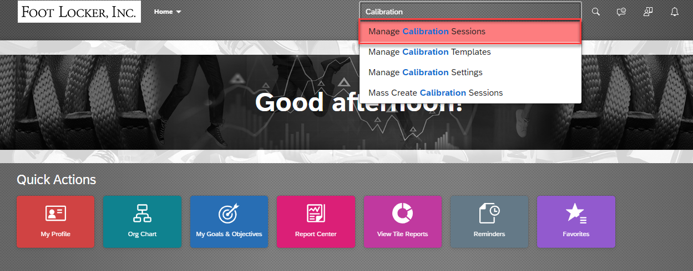
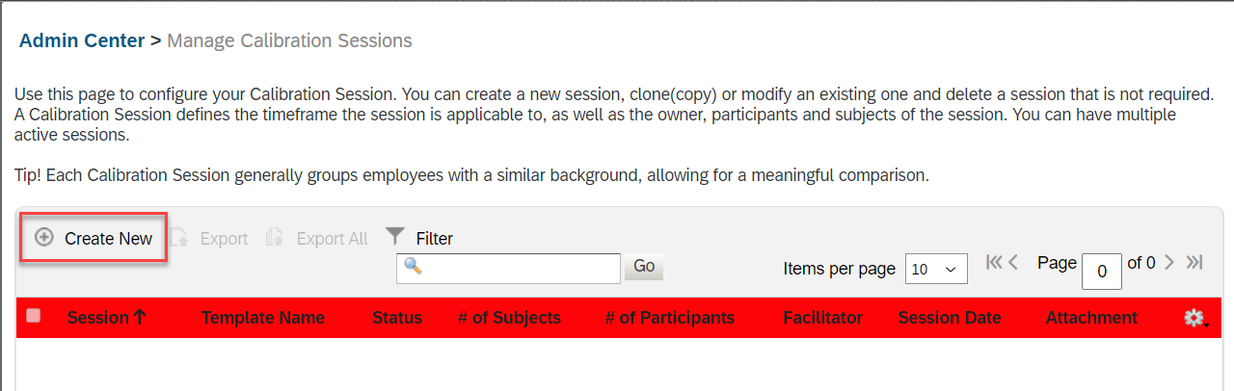
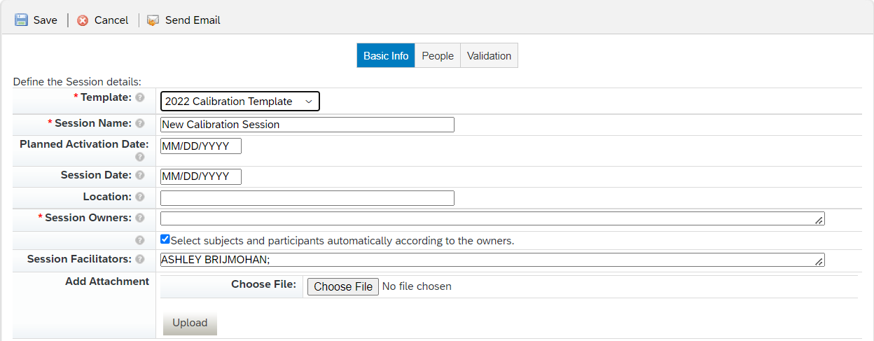
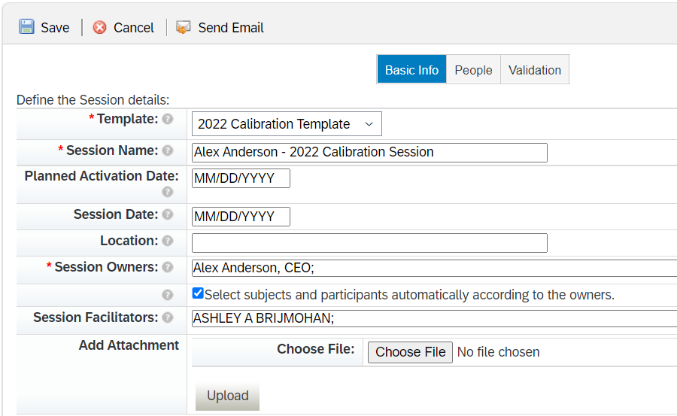
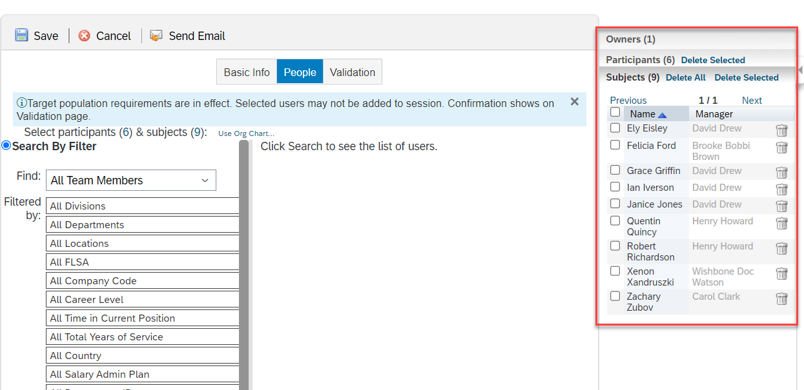
SuccessFactors: Creating a Calibration Session
Search for Calibration and select Manage Calibration Sessions
Note: To include Team Members in a Calibration Session, they need to be in the “Calibration” step of the Performance Process prior to creation.
Team Members must also have their EDR information completed prior to a session creation.
Talent Category
Risk of Loss
Impact of Loss
Create a new session by clicking on Create New
There are 3 steps to complete the creation of a Calibration Session:
Basic Info
People
Validation
Basic Info
1. The 2022 Calibration Template will pre-populate.
2. Create Session Name. Use naming convention: “Leader/Owner Name” – 2022 Calibration Session
3. Input Session Owners: These are the leaders of the session.
4. Input Session Facilitators: This is typically HR. Can be more than 1 HR team member.
Note: You can choose to automatically have subjects and participants populate on the People tab or manually select them during that step by unchecking.
People
If the “Select subjects and participants….” box is checked off in the Basic Info tab, participants and subjects will populate on the right. You can delete accordingly.
Note:
The Owner: Leader of Calibration session
Participants: Those one level below the Owner. They are managers of the Subjects.
Subjects: Individuals being calibrated in the session.

Slide 2
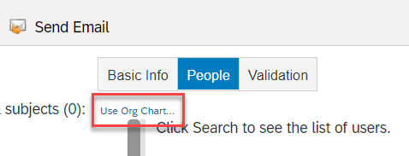
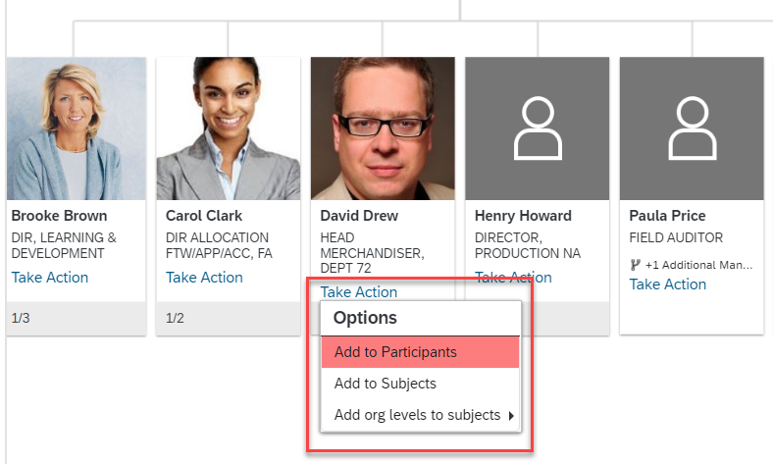
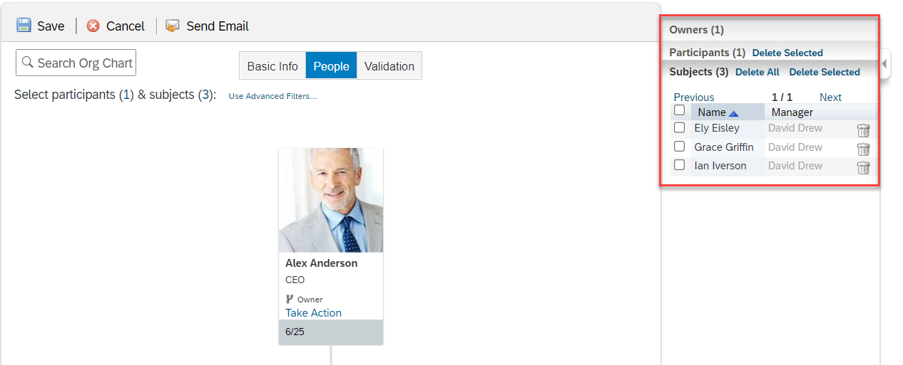
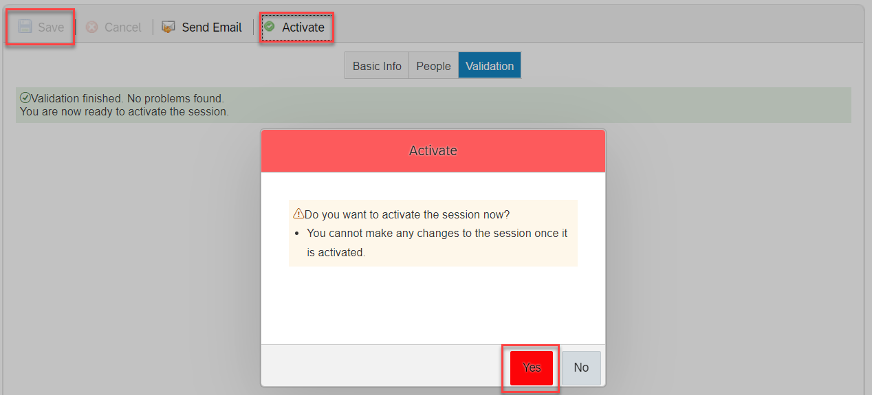
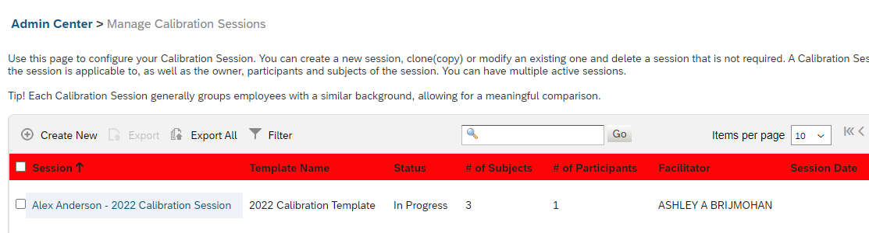
SuccessFactors: Creating a Calibration Session (continued)
If you did not select the check box to automatically move the participants and subjects over, you can do so with an org chart or with advanced filters (Org Chart is advised).
Select the gray area with the team member count to view Org levels for selection.
To move Subjects and Participants into the session, select “Take Action” and “Add to Participants” or “Add to Subjects”.
Added Subjects and Participants will appear on the right-hand side.
Note: Calibration is best facilitated with sessions of no more than 200-500 employees.
Validate
1. Save the creation of the session.
2. Activate the session to validate the changes.
3. Select Yes to confirm the creation of the Calibration Session.
The system will let you know if there is any reason why you are unable to move forward with creating the calibration session.
Note: If you receive an error during validation, you will have to recreate the session. You can not save this session and edit once it has been created.
The Calibration Session(s) created by the HR Champion will appear in their Sessions list.

